Slide 1
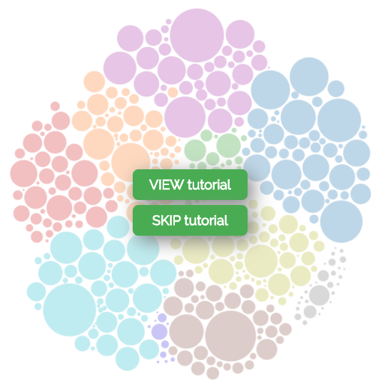
Pave
Is a Canadian
Job Explorer

Slide 2


You can use Pave to quickly explore the Canadian job market from different angles.
Tutorial 1/4

Slide 3
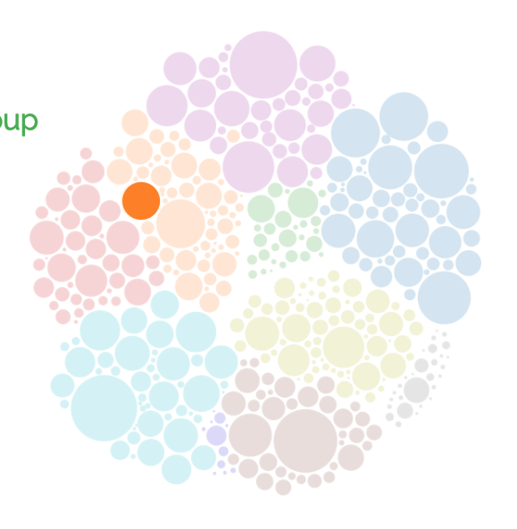

Each circle represents a job group Hover over the circle on the right to see job details
Tutorial 2/4

Slide 4
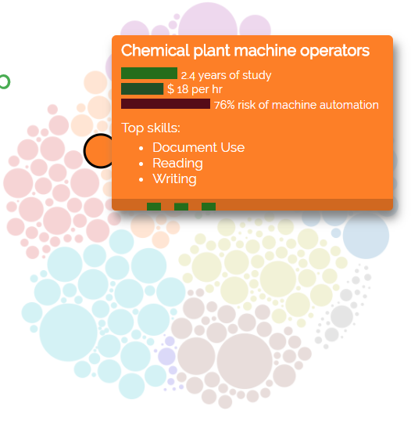
Each circle represents a job group Hover over the circle on the right to see job details Click the circle on the right to see skills used on the job
Tutorial 2/4

Slide 5


Each circle represents a job group Hover over the circle on the right to see job details Click the circle on the right to see skills used on the job
Tutorial 2/4

Slide 6

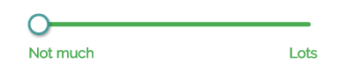
Changing the skill sliders lets you look at jobs that different people would qualify for, based on their different skillsets.
Tutorial 3/4

Slide 7
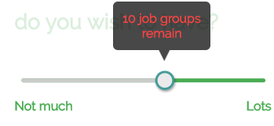

Changing the skill sliders lets you look at jobs that different people would qualify for, based on their different skillsets.
Tutorial 3/4

Slide 8

Tutorial 4/4

Slide 9


Tutorial 4/4

